Slide 1
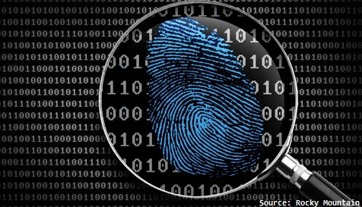
CS483 Digital Forensics
Lesson 2 – Forensic Examinations

Slide 2
Review Questions
What can Digital Forensic Efforts Provide?
What is the Daubert Standard?
What are the Daubert Factors?
What is Locard’s Exchange Principle?
What is the Observer Effect?

Slide 3
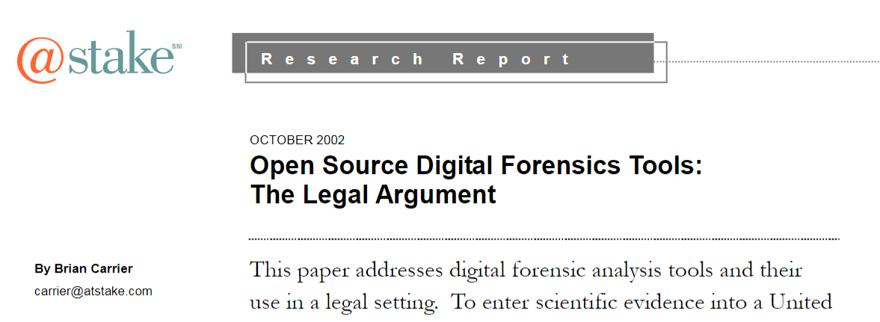
Paper Discussion

Slide 4
Lesson Overview
Digital Investigations
Forensics Reporting
Incident Response
Forensics Driven CTI

Slide 5
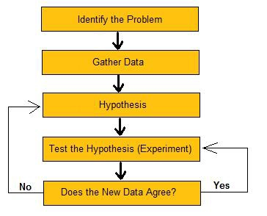
Digital Investigation
Process to develop and test hypotheses to answer questions about digital events
Use scientific method
Digital evidence – Digital object that supports or refutes a hypothesis
Notes:
A digital investigation is a process where we develop and test hypotheses that answer questions about digital events. This is done using the scientific method where we develop a hypothesis using evidence that we find and then test the hypothesis by looking for additional evidence that shows the hypothesis is impossible. Digital evidence is a digital object that contains reliable information that supports or refutes a hypothesis.

Slide 6
Considerations
Best Evidence Rule
Digital Search Warrants
OPSEC
Notes:
Directly from: https://www.justice.gov/file/442111/download:
The best evidence rule states that to prove the content of a writing, recording, or photograph, the “original” writing, recording, or photograph is ordinarily required. See Fed. R. Evid. 1002. For example, in United States v. Bennett, 363 F.3d 947, 953 (9th Cir. 2004), in an effort to prove that the defendant had imported drugs from international waters, an agent testified about information he viewed on the screen of the global positioning system (GPS) on the defendant’s boat. The Ninth Circuit found that the agent’s testimony violated the best evidence rule. The agent had only observed a graphical representation of data recorded by the GPS system; he had not actually observed the boat following the purported path. Because the United States sought to prove the contents of the GPS data, the best evidence rule required the government to introduce the GPS data itself or the printout of that data, rather than merely the agent’s testimony about the data. Alternatively, the government could have sought to demonstrate that the original GPS data was lost, destroyed, or otherwise unobtainable under Fed. R. Evid. 1004, but the court ruled that the government had failed to do.
Agents and prosecutors occasionally express concern that a mere printout of a computer-stored electronic file may not be an “original” for the purpose of the best evidence rule. After all, the original file is merely a collection of 0’s and 1’s; in contrast, the printout is the result of manipulating the file through a complicated series of electronic and mechanical processes. The Federal Rules of Evidence have expressly addressed this concern. The Rules state that “[i]f data are stored in a computer or similar device, any printout or other output readable by sight, shown to reflect the data accurately, is an ‘original’.” Fed. R. Evid. 1001(3). Thus, an accurate printout of computer data always satisfies the best evidence rule. See Doe v. United States, 805 F. Supp. 1513, 1517 (D. Haw. 1992). According to the Advisory Committee Notes that accompanied this rule when it was first proposed, this standard was adopted for reasons of practicality: While strictly speaking the original of a photograph might be thought to be only the negative, practicality and common usage require that any print from the negative be regarded as an original. Similarly, practicality and usage confer the status of original upon any computer printout. Advisory Committee Notes, Proposed Federal Rule of Evidence 1001(3) (1972). However, as with demonstrating authenticity, a proponent might need to demonstrate that the print out does accurately reflect the stored data in order to satisfy the best evidence rule. Compare Laughner v. State, 769 N.E. 2d 1147, 1159 (Ind. Ct. App. 2002) (AOL Instant Message logs that police had cut-and pasted into a word-processing file satisfied best evidence rule) (abrogated on other grounds by Fajardo v. State, 859 N.E. 2d 1201 (Ind. 2007)), with United States v. Jackson, 488 F. Supp. 2d 866, 871 (D. Neb. 2007) (word-processing document into which chat logs were cut-and-pasted was not the “best evidence” because it did not accurately reflect the entire conversation). Similarly, properly copied electronic data is just as admissible as the original data. Rule 1003 states that a “duplicate is admissible to the same extent as an original” unless there is a genuine question about the original’s authenticity or there is some other reason why admitting the duplicate would be unfair. A “duplicate” is defined, by Rule 1001(4), as “a counterpart produced by the same 206 Searching and Seizing Computers impression as the original . . . or by mechanical or electronic re-recording . . . or by other equivalent techniques which accurately reproduces the original.” Thus, a proponent can introduce, for instance, an image of a seized hard drive, where the proponent can demonstrate that the imaging process accurately copied the data on the original hard drive. Tis demonstration is often accomplished through testimony showing that the hash value of the copy matches that of the original.

Slide 7
Evidence Acquisition
Memory Captures
Disk Captures
Live System Response
Preserve the original evidence
Cryptographic Hash for integrity verification

Slide 8
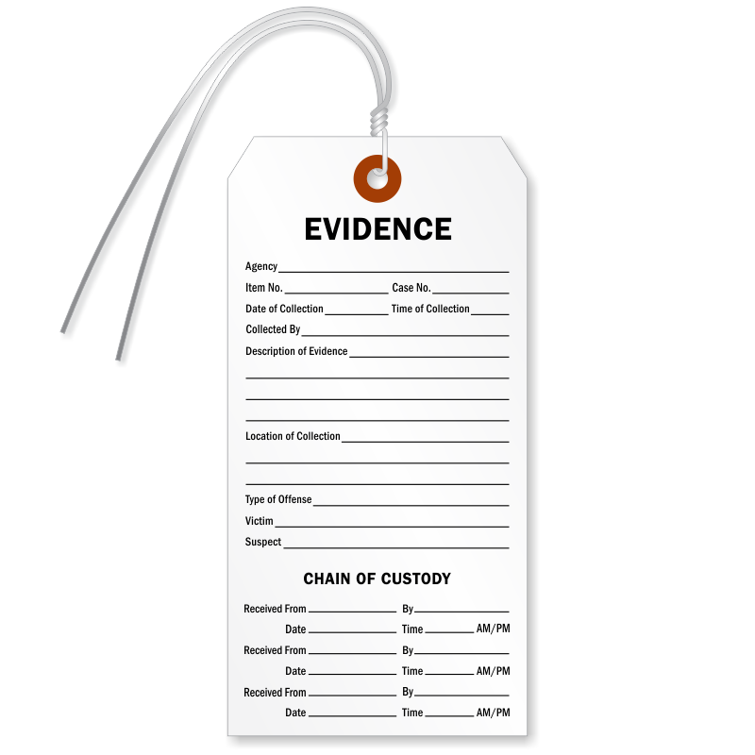
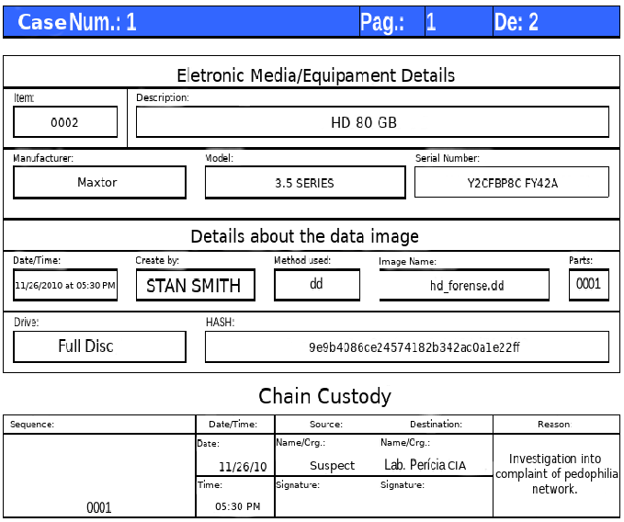

Chain of Custody
Record of artifact movement

Slide 9
Forensics Reporting
The output of a forensic investigation can vary
Expert witness testimony
Forensics report
CTI Report
Expert witness testimony
IOCs to inform detection and mitigation

Slide 10
Forensics Reporting
Know your audience
Document your process
Daubert Standard
Details
Written reports
Label and describe figures
Screenshots
Evaluation
Analysis of competing hypotheses
Clearly define confidence in conclusions

Slide 11
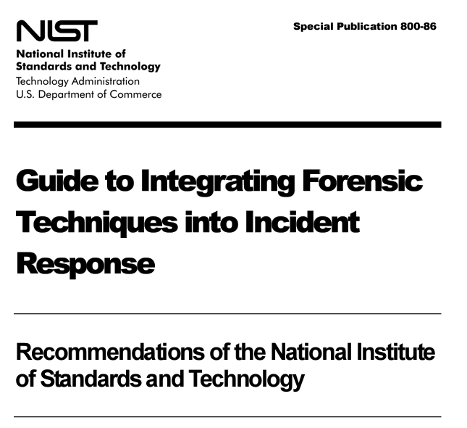
Forensics Should be Integrated into IR

Slide 12
Incident Response Steps
Preparation
Plan, be ready
Identification
Is there a problem here?
Containment
Control the bleeding
Eradication
Eliminate the problem
Recovery
Return to full operation
Lessons Learned
Prevent future incidents and improve the response process.

Slide 13

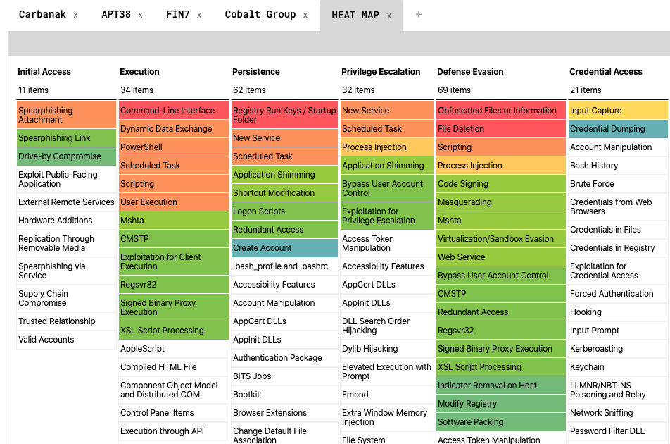
Forensics Driven CTI
Reconnaissance
Weaponization
Delivery
Exploitation
Installation
Command and Control
Actions on the Objective
Cyber Kill Chain
Diamond Model
MITRE ATT&CK

Slide 14
Forensics Driven CTI
Cyber Threat Intelligence (CTI) is often created from forensics and IR reports
IOCs
Attacker motivation and intent
Targeting / Victimology
Who is the attacker targeting?
Battle Damage Assessments
The earlier in the kill chain you can intercept the attack, the less likely the attacker will achieve their desired end state

Slide 15
Summary
Digital Investigations
Forensics Reporting
Incident Response
Forensics Driven CTI

Slide 16
If You Remember 4 Things…
Everything is a data structure.
It’s all code. Not magic.
Abstraction leaves gaps.
Own your tools.

Slide 17
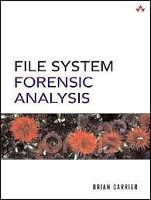
For Next Lesson
Read Chapters 1-3 from File System Forensic Analysis (Carrier)

